Slide 1
Future Technology
Made by Angel Zhelyazkov and Atanas Burmov

Slide 2
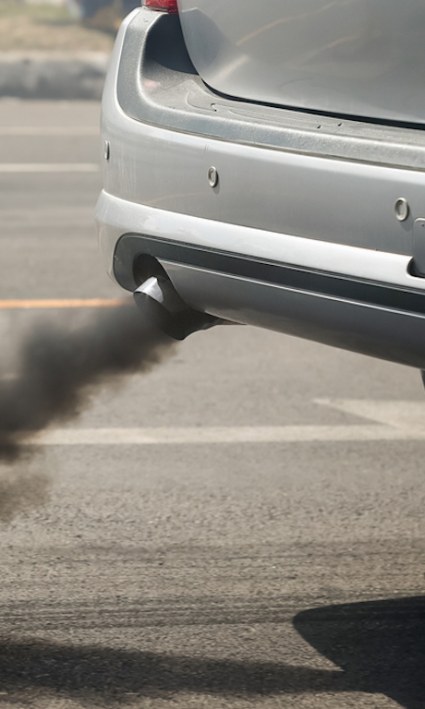
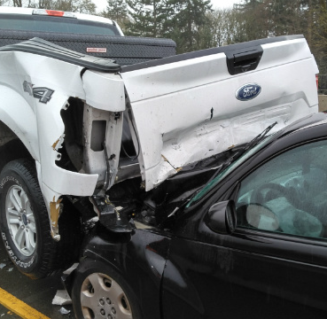
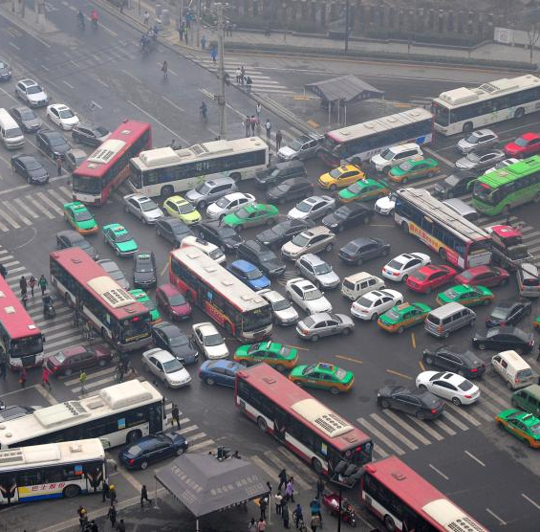
TRANSPORT PROBLEms
- Carbon Emissions
- Traffic Congestion
- Landscape Destruction
- Crashes
- Air Pollution

Slide 3
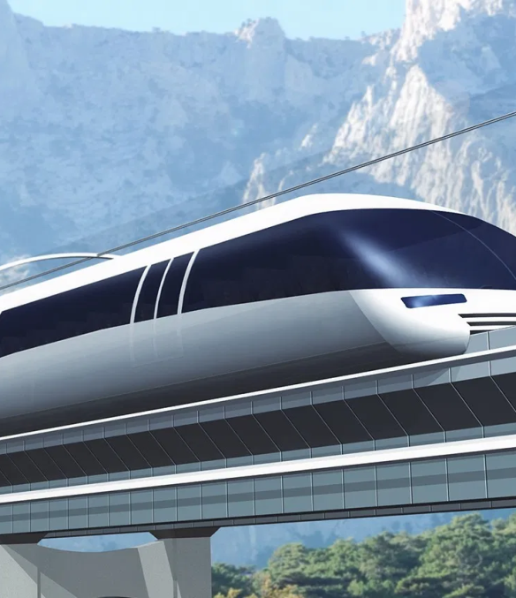
The hyperloop
Our team “Future Technology” is delighted to present you The Hyperloop! It's a transport capsule or system of capsules through which a pod may travel free of air resistance, or friction conveying people or objects at high speed while being very efficient, thereby drastically reducing travel times over medium and big-range distances.

Slide 4
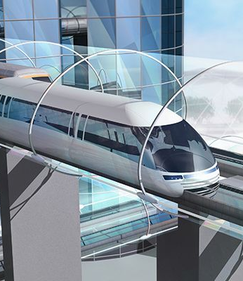
The transport
Instead of slow and uncomfortable city busses, we could be using the tube transport “HyperLoop”. We won’t wait for it for a long time, because it will be traveling within 1200km/h. About the amenities, It will be more comfortable, because there are more than 20 self-warming seats in one capsule. Of the fully natural movement, the costs will be cheaper and decreased.

Slide 5
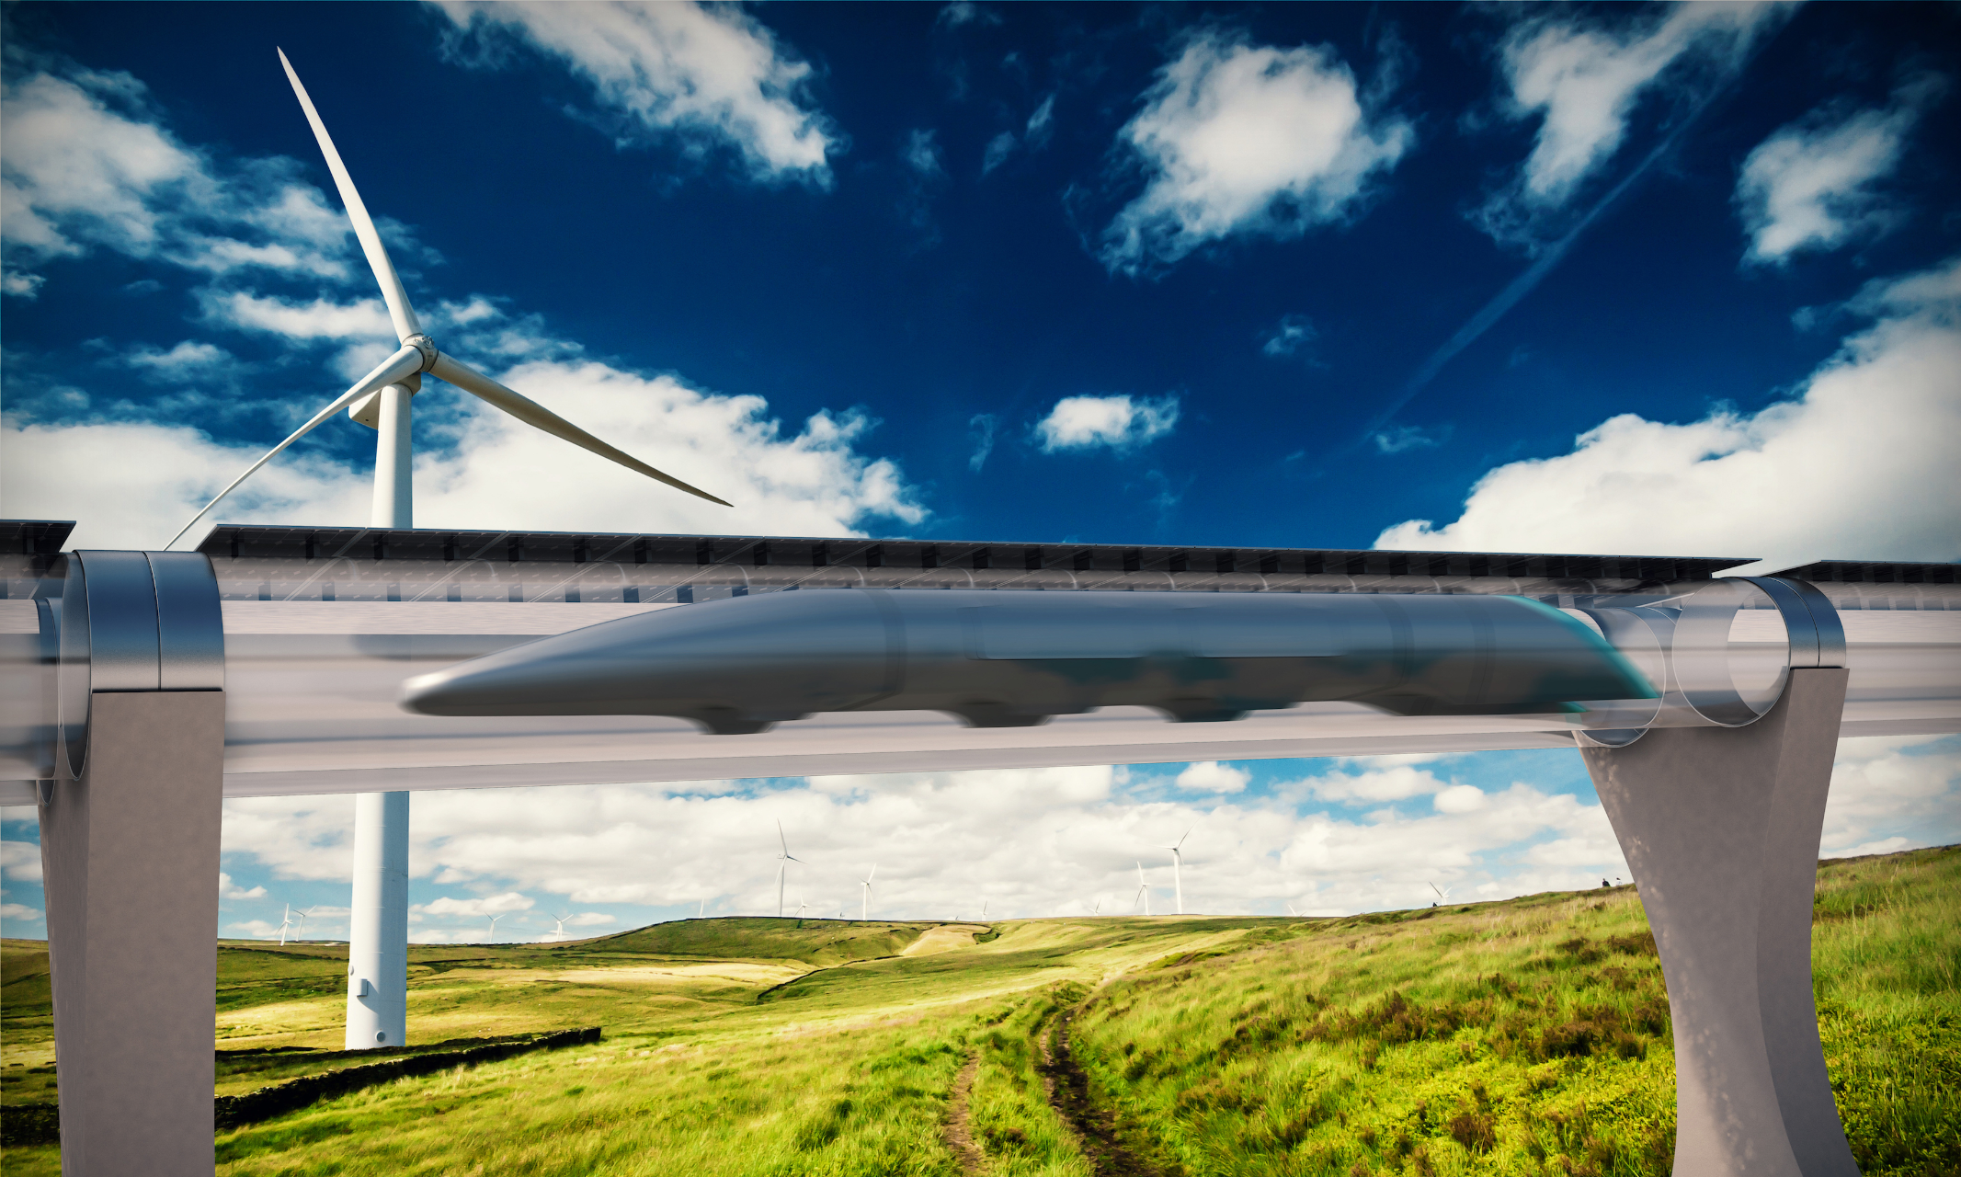
Thank you for your attention

